Slide 1
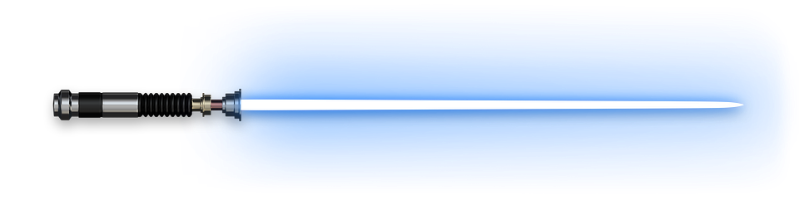
Equilibrium of Forces
(No Star Wars Puns, There Are…)

Slide 2
Applied Force
Forces are being applied to objects (including ourselves) at all times. Those forces can be either balanced or unbalanced.
Newton’s 1st Law (the Law of Inertia) states:
“The motion of an object shall remain constant (unchanged) until said object is acted upon by an unbalanced force”.
When the motion of an object is changing (either speed or direction), the object is said to be accelerating. Therefore, we can conclude that acceleration is due to the action of unbalanced forces.

Slide 3
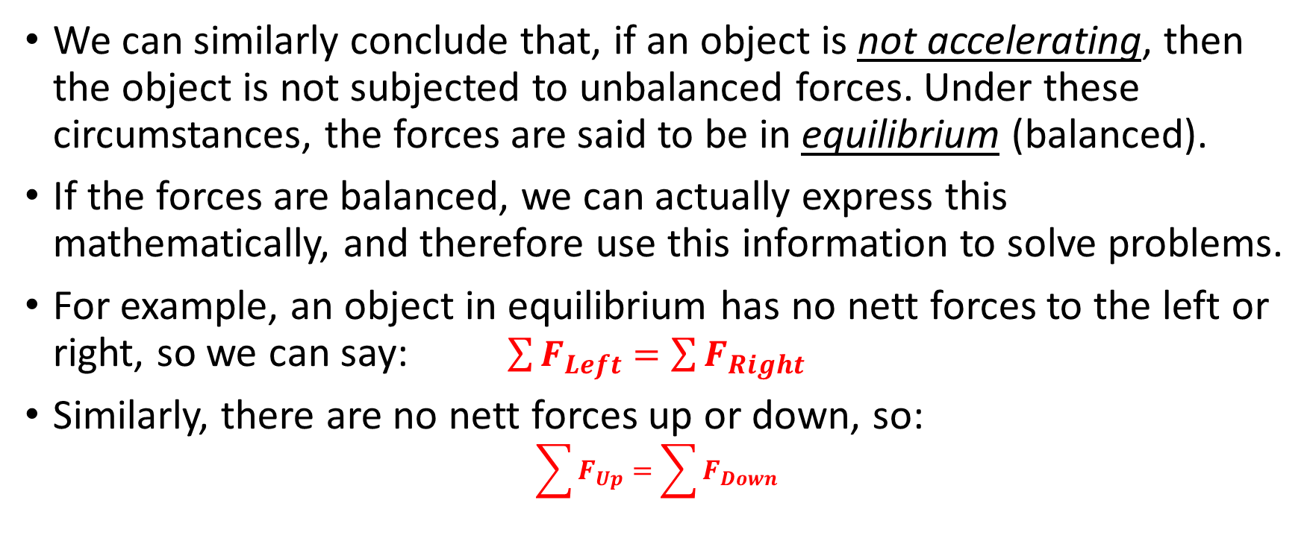
Applied Force
We can similarly conclude that, if an object is not accelerating, then the object is not subjected to unbalanced forces. Under these circumstances, the forces are said to be in equilibrium (balanced).
If the forces are balanced, we can actually express this mathematically, and therefore use this information to solve problems.
For example, an object in equilibrium has no nett forces to the left or right, so we can say: $\sum{F_{Left}=\sum{F_{Right}}}$
Similarly, there are no nett forces up or down, so:
$$\sum{F_{Up}=\sum{F_{Down}}}$$
Notes:
There are different forms of equilibrium – we’re dealing with static equilibrium (as opposed to rotational equilibrium).

Slide 4
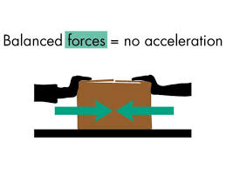
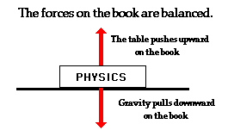
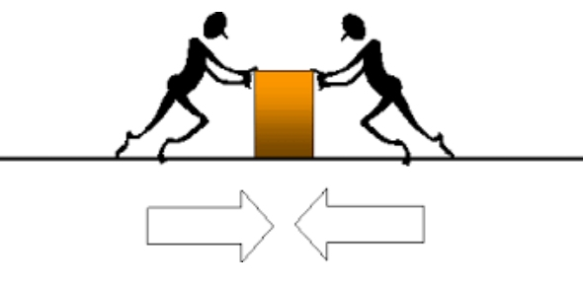
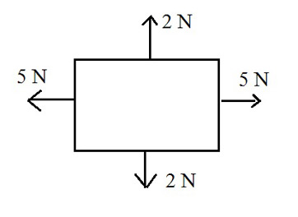


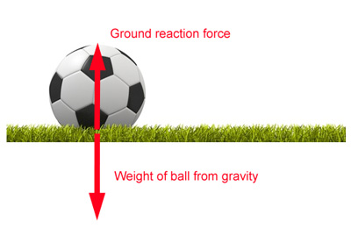
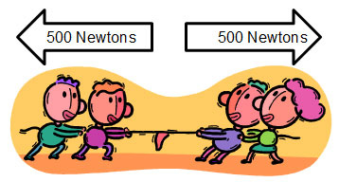

Slide 5
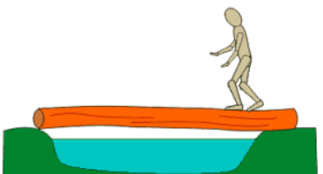
Applying Equilibrium Conditions
1.80 x 10³ N
Consider the following:
The mass of the man on the log is 60 kg.
The mass of the log is 240 kg.
The force acting upwards at ‘B’ is 1.14 x 10³ N.
What is the force acting at ‘A’?
Convert masses to forces.
Apply
1.14 x 10³ + F_{A} = 2352 + 588
Solve for F_{A}
1.14 x 10³ N
?
B
A
240 x 9.8
60 x 9.8
= 2352 N
= 588 N

Slide 6
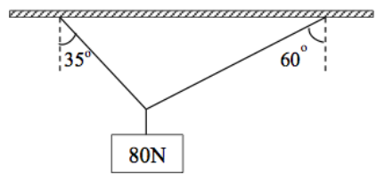
Applying Equilibrium Conditions
Find the tension in each string.
Break forces down into horizontal and vertical components.
Find expressions for these components in terms of T₁ & T₂ (use SOH CAH TOA).
Apply Equilibrium Conditions:
T₁
T₂
T₁ cos 35˚
T₂ cos 60˚
T₁ sin 35˚
T₂ sin 60˚
T₁ sin 35˚ = T₂ sin 60˚
We now have 2 equations that we can solve simultaneously, so let’s do that…
T₁ cos 35˚ + T₂ cos 60˚ = 80

Slide 7

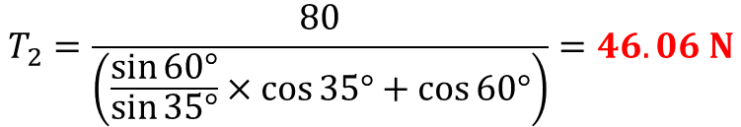
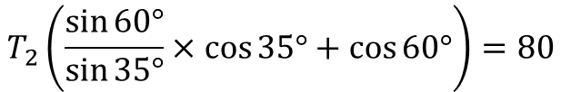


Applying Equilibrium Conditions
Find the tension in each string.
T₁
T₂
T₁ cos 35˚
T₂ cos 60˚
T₁ sin 35˚ = T₂ sin 60˚
(1)
T₁ sin 35˚
T₂ sin 60˚
T₁ cos 35˚ + T₂ cos 60˚ = 80
(2)
$$T_{1}=\frac{T_{2}\sin{60°}}{\sin{35°}}$$
Rearrange (1)
Sub T₂ into eqn. for T₁ & solve:
$$\frac{T_{2}\sin{60°}}{\sin{35°}}×\cos{35°}+T_{2}\cos{60°}=80$$
Sub into (2)
$$T_{1}=\frac{46.06\sin{60°}}{\sin{35°}}=69.55 N$$
$$T_{2}\left(\frac{\sin{60°}}{\sin{35°}}×\cos{35°}+\cos{60°}\right)=80$$
Solve for T₂
$$T_{2}=\frac{80}{\left(\frac{\sin{60°}}{\sin{35°}}×\cos{35°}+\cos{60°}\right)}=46.06 N$$
Notes:
Could have isolated T₁ instead and proceeded that way, it makes no difference.

Slide 8
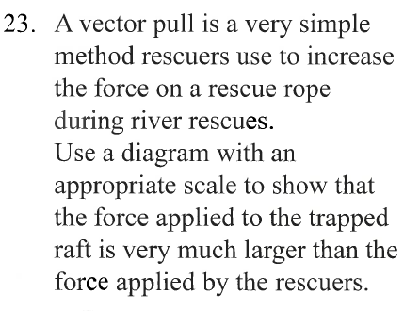
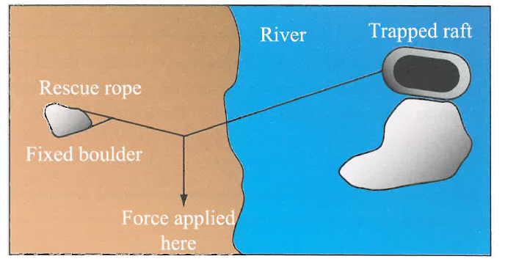
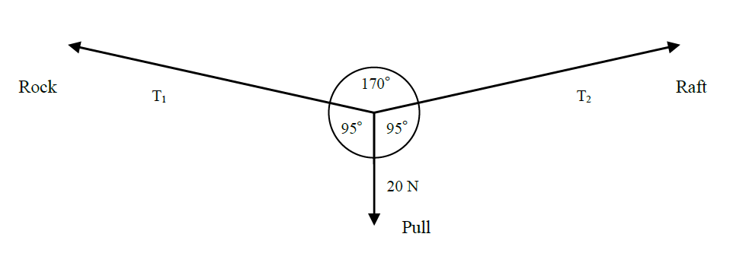
Notes:
T₂ = 114.7 N. This is greater than the 20 N “force applied here”, hence we have proof on concept – QED. Note that we don’t assume that the two tensions are equal to begin with, but it will come out that way in the working out and the solutions, so this result is not a guess but a consequence of the working out.

Slide 9




